Slide 1
FIDO UAF Multi-factor Authentication

Slide 2
Agenda
Motivation for FIDO
FIDO UAF
Overview
FIDO Operations
References

Slide 3
Motivation for FIDO
WHY?

Slide 4


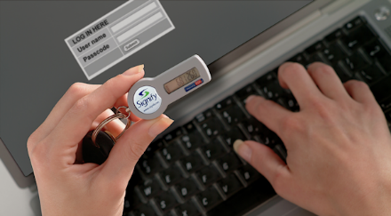
Authentication methods

Slide 5
Issues with Current Authentication Methods - Password
Stored on Server
Phishing attacks
Too Many Passwords
Could be stolen by hackers
Symmetric in nature
User might be lured to enter them in untrusted websites
User needs to remember passwords for each website/app
Each will have varying level of complexity requirements.

Slide 6
Issues with Current Authentication Methods – OTP/Tokens
MITM
SMS Security
Need for Multiple devices
Vulnerable to Man-in-the-middle attacks
SMS Security is a concern
One device for token generation and other to key-in the token

Slide 7
Issues with Current Authentication Methods – Risk Levels
Login to account
Change address
Transfer $100
Transfer $10000
One authentication for all risk levels.
No upgrade/downgrade in complexity based on risk level of transaction
LOW
HIGH
RISK
Notes:
Client side authentication methods like finderprint, gesture need to be replicated on serverside. So all these remain symmetric authentication.

Slide 8
FIDO UAF
WHAT?

Slide 9


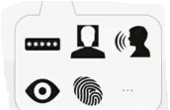
FIDO – Universal Authentication Factor (UAF)
User Verification
Authenticator
FIDO Authentication
Notes:
User verification method can be added without any change on server software

Slide 10
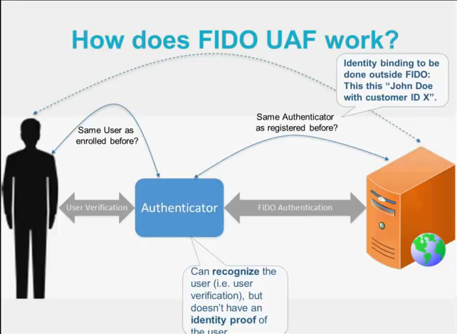

Slide 11
UAF Protection
Metadata service to define authenticator Model
Define policy for acceptable authenticators at server
Stores only public keys at server (no secrets)
Use TLS channel binding to protect against MITM
Separation of User Verification from authentication with server

Slide 12
FIDO UAF
Important Terminologies

Slide 13
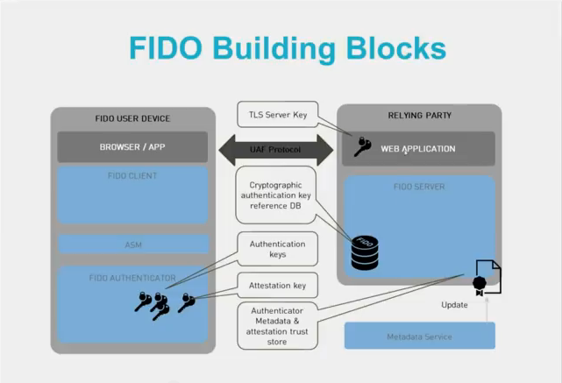
Notes:
Authentication keys – one per each relying party

Slide 14
Important Terminologies
FIDO Client
This is the software entity processing the UAF protocol messages on the FIDO User Device. FIDO Clients may take one of two forms:
A software component implemented in a user agent (either web browser or native application).
A standalone piece of software shared by several user agents. (web browsers or native applications).
FIDO Server
Server software typically deployed in the relying party’s infrastructure that meets UAF protocol server requirements.

Slide 15
Important Terminologies …
Relying Party
A web site or other entity that uses a FIDO protocol to directly authenticate users (i.e., performs peer-entity authentication).
AAID – Authenticator Attestation ID
A unique identifier assigned to a model, class or batch of FIDO Authenticators that all share the same characteristics, and which a Relying Party can use to look up an Attestation Public Key and Authenticator Metadata for the device.
AAID is string with V#M format where
V = Vendor Code consisting of 4 digit Hex value
M = Model Code consisting of 4 digit Hex value
# = Separator
e.g. EBA0#0001

Slide 16
Important Terminologies …
Facet ID
A platform-specific identifier (URI) for an application facet.
For Android applications, the facet id is the URI android:apk-key-hash:<hash-of-apk-signing-cert>
For iOS, the facet id is the URI ios:bundle-id:<ios-bundle-id-of-app>
Attestation
Its how the Authenticator claim to a Relying Party that the keys they generate originate from genuine devices with certified characteristics
Attestation Key
Key used for FIDO Authenticator attestation
Authenticator Attestation
The process of communicating a cryptographic assertion to a relying party that a key presented during authenticator registration was created and protected by a genuine authenticator with verified characteristics.

Slide 17
FIDO UAF
Operations

Slide 18
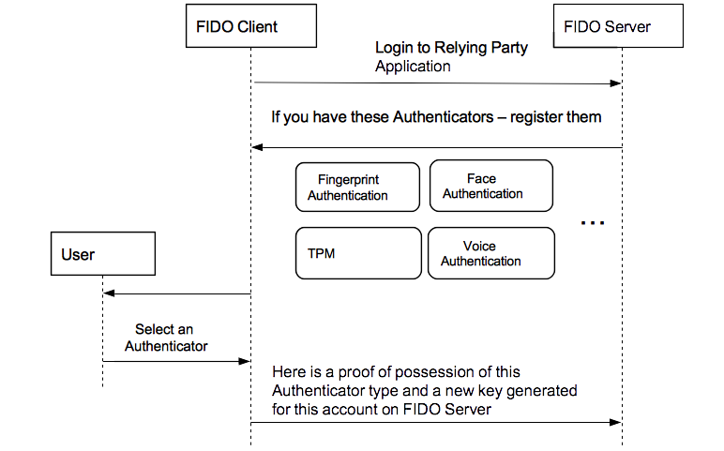
Register

Slide 19
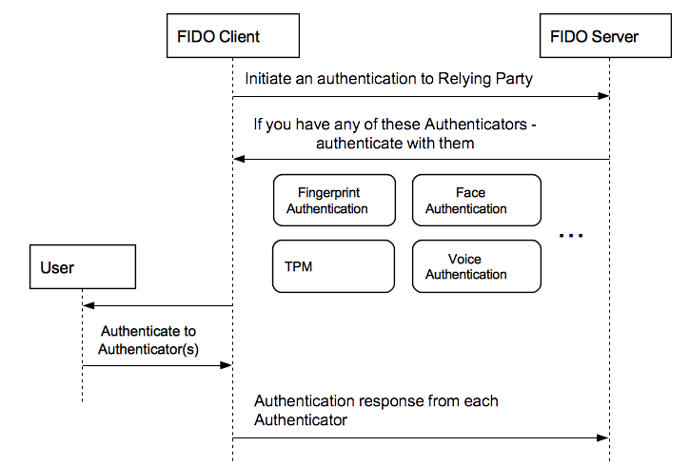
Authenticate

Slide 20
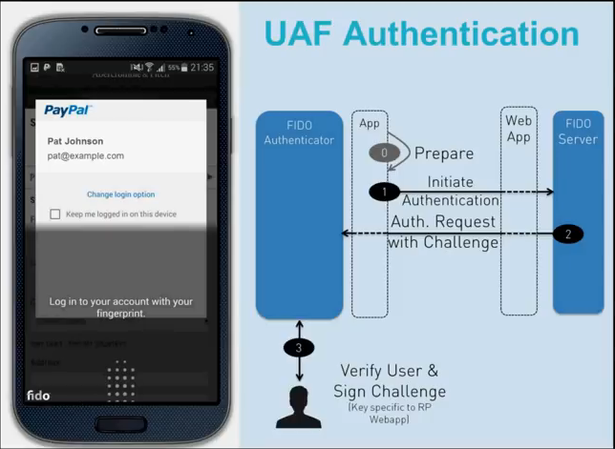
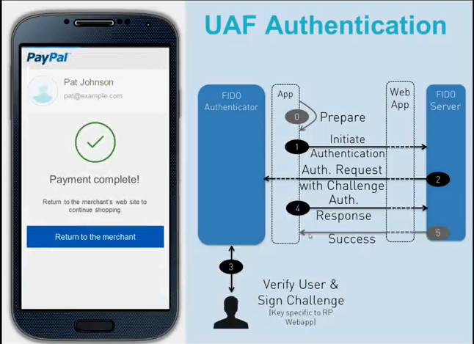
Notes:
Final Challenge = AppID | FacetID | Channel Binding | challege

Slide 21
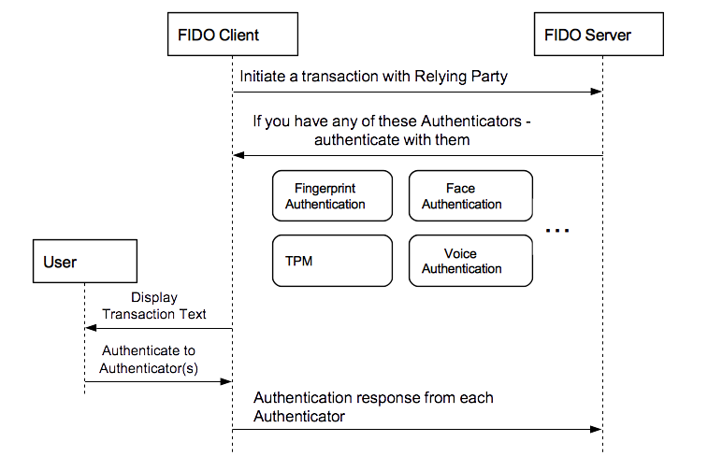
Transaction Confirmation

Slide 22
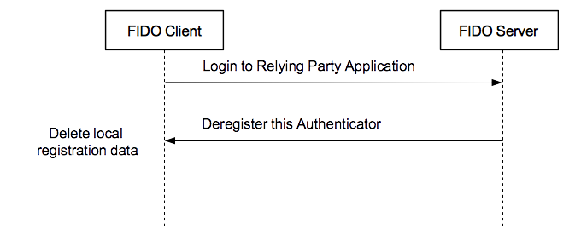
Deregister

Slide 23
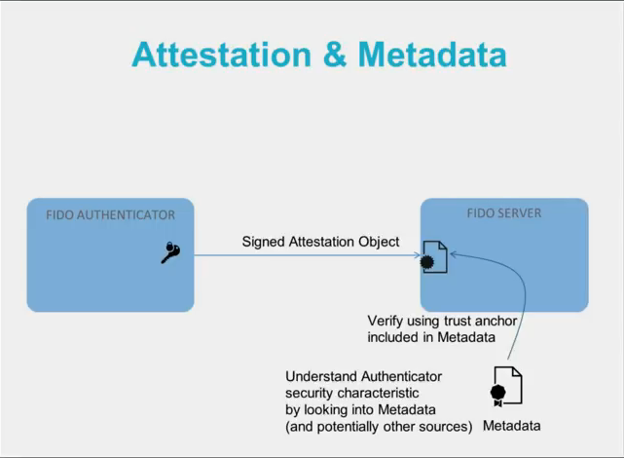
Metadata Service

Slide 24
References
FIDO Alliance – www.fidoalliance.org
FIDO UAF Protocol Specification v1.0 - https://fidoalliance.org/specs/fido-uaf-v1.0-ps-20141208/fido-uaf-protocol-v1.0-ps-20141208.html
FIDO UAF Registry of Predefined Values - https://fidoalliance.org/specs/fido-uaf-v1.0-ps-20141208/fido-uaf-reg-v1.0-ps-20141208.html
FIDO UAF Primer - https://www.youtube.com/watch?v=qEY8UbjmhNo
FIDO Technical Glossary - https://fidoalliance.org/specs/fido-uaf-v1.0-ps-20141208/fido-glossary-v1.0-ps-20141208.html

Slide 25


